Slide 1
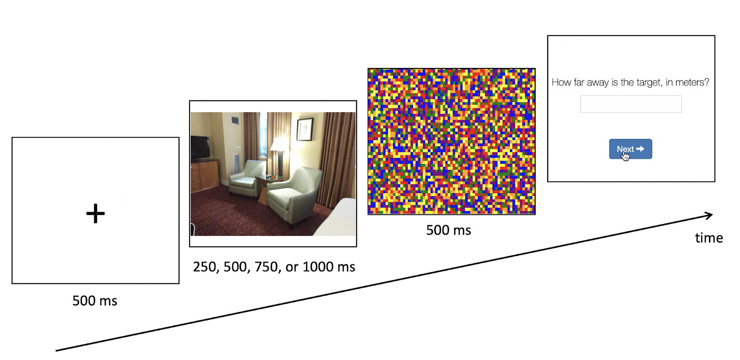
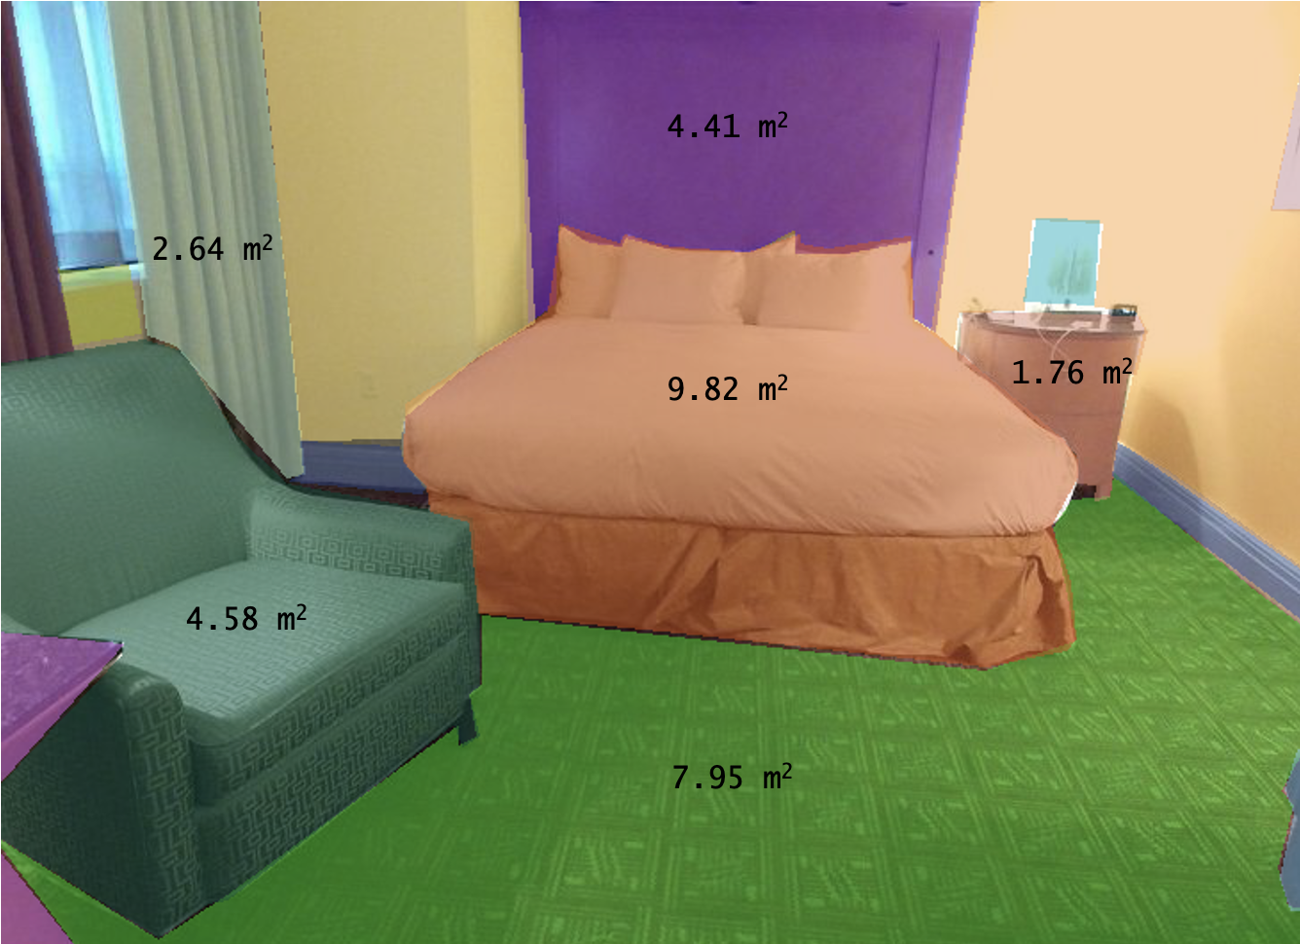
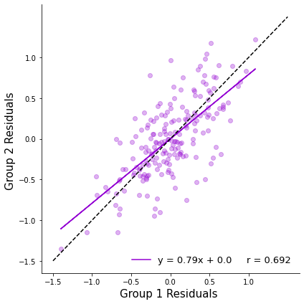
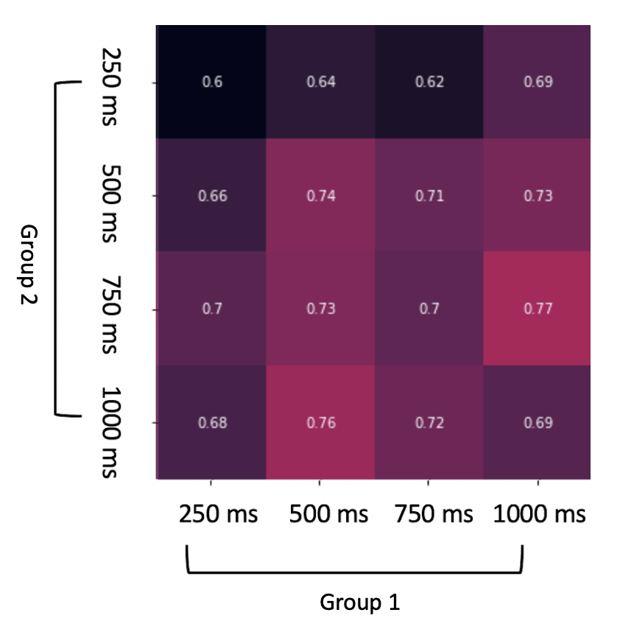
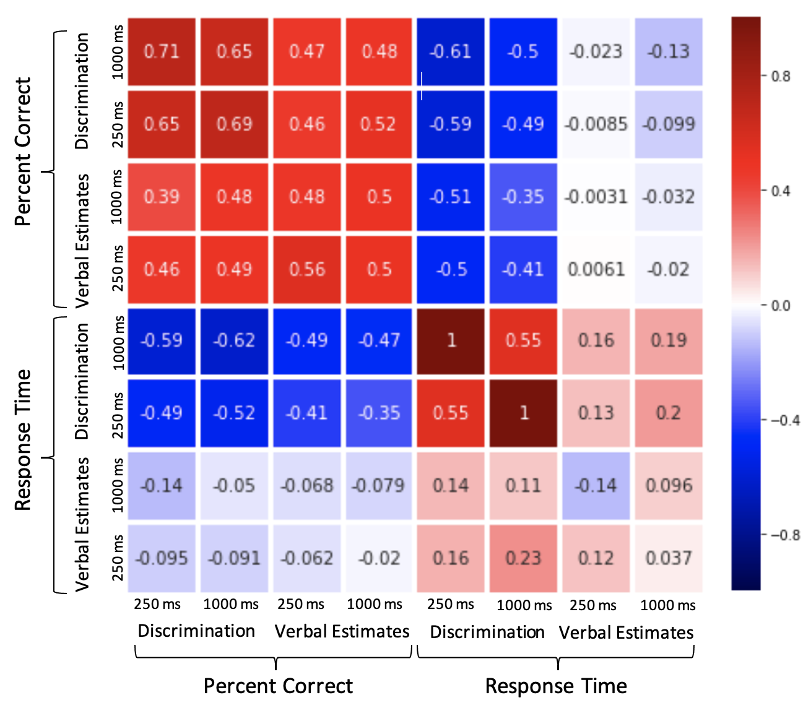
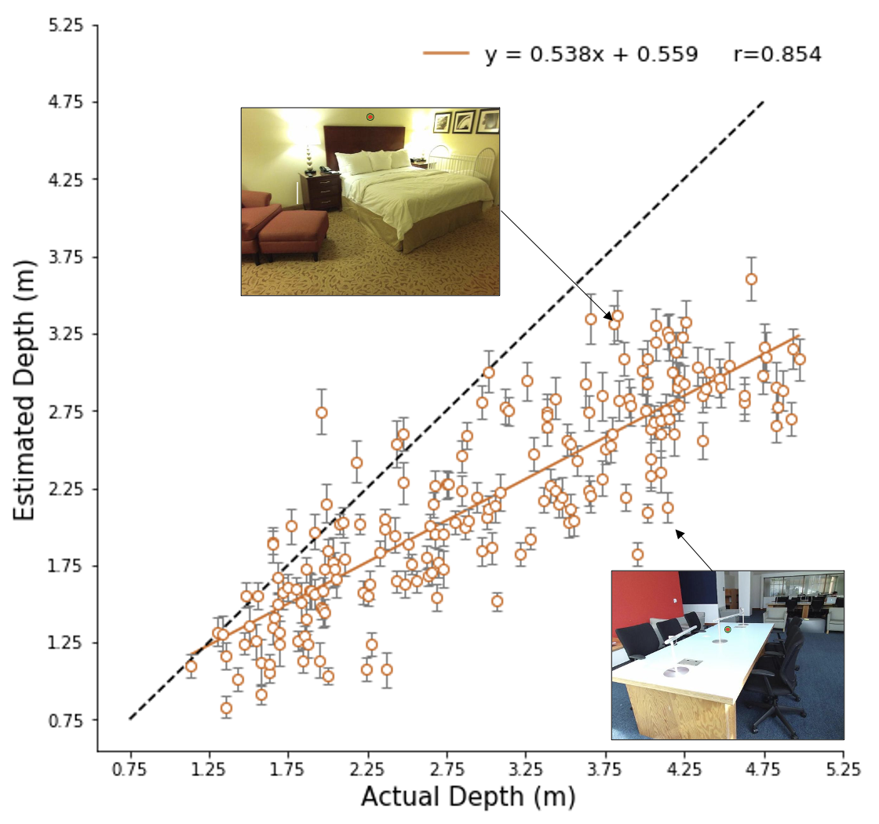
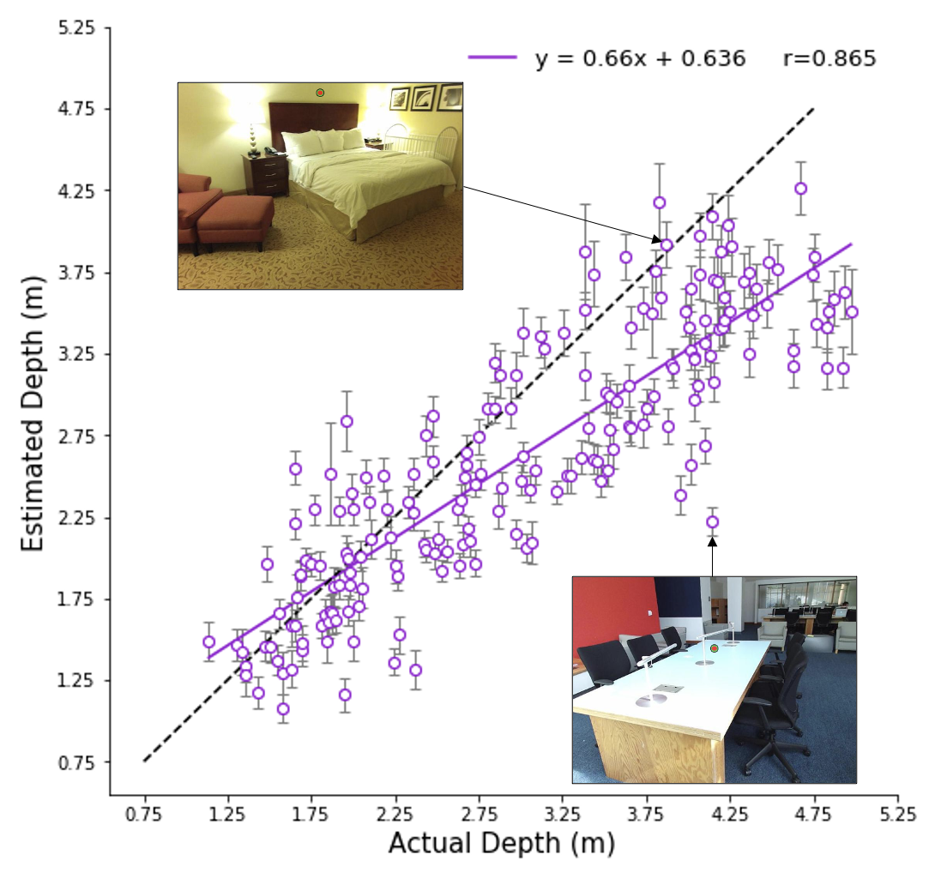
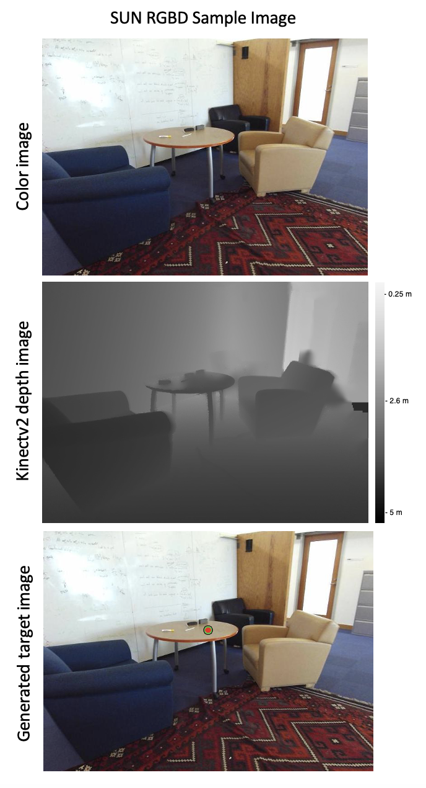
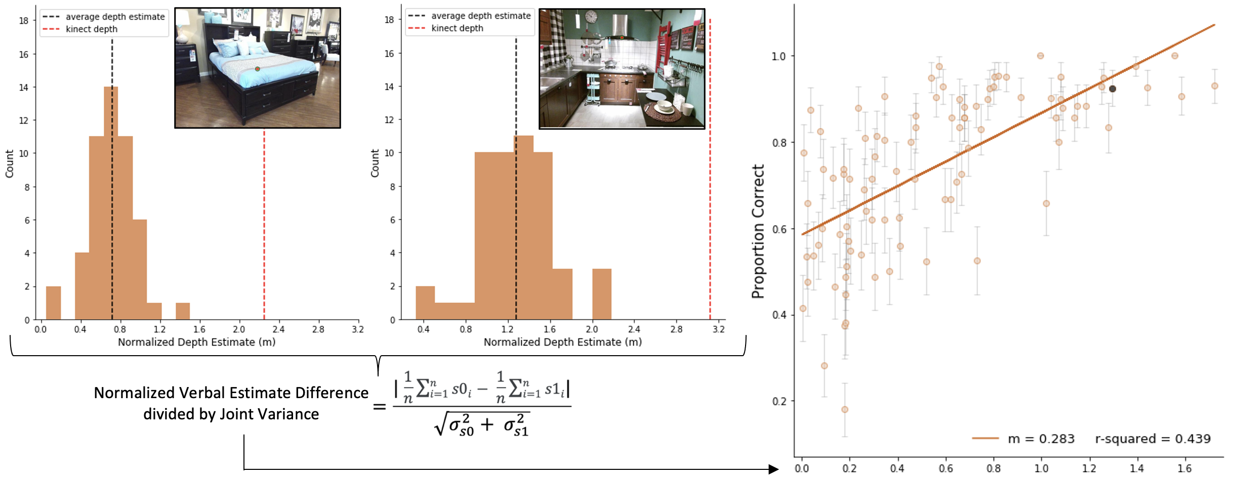
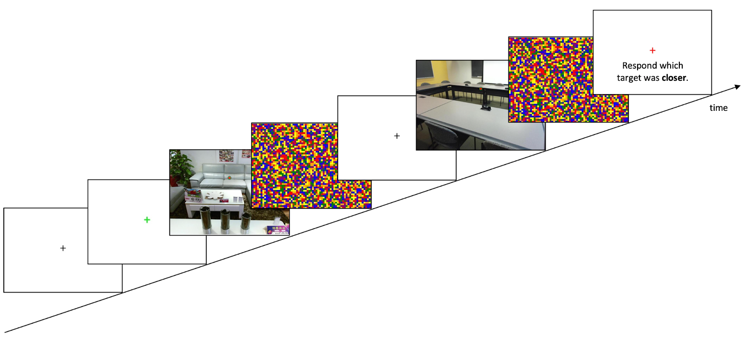
A Novel Generalization between Verbal Judgments and
Perceptual Discrimination of 3D Space
Prachi Mahableshwarkar, John Philbeck, and Dwight Kravitz
Department of Psychological and Brain Sciences, The George Washington University
Introduction
Visual spatial perception depends on integrating multiple sources of information over time to form a stable percept
Based on prior work in this field, we hypothesize that human visual distance perception in pictured scenes optimally integrates visual distance cues with temporal processing differences.
We leverage the SUN-RGBD database paired with a novel approach to crowd-sourced data collection to understand spatial perception within pictured scenes.
We use two matched tasks focusing on depth perception (discrimination, verbal report) and quantify their shared variance across a large set of images
Measuring sensitivity to distance information using results from two independent paradigms will help clarify the temporal characteristics of visual scene understanding in pictures and have important implications for theories of picture and scene perception
Experiment 1: Verbal Judgements of Depth
DESIGN
Participants viewed images with targets at variable distances from the SUN RGB-D database and made egocentric distance estimations (Fig 3)
N = 192, Amazon Mechanical Turk workers
Duration is manipulated between subjects
156 targets ranging in distance between 1 meter - 5 meters will be presented in individual trials.
Response time is collected and log transformed prior to analysis
RESULTS
Distance estimates to individual scenes showed increasing sensitivity to distance with longer viewing durations (F = 15.32, p < 10^-9) (Fig 4A, B).
Participants generally underestimate depth, but there is strong systematicity in their responses
Stimuli
All images in the dataset were taken with the Kinectv2 sensors, so the “ground truth” distance of each target was extracted from the depth array for each image in the SUN-RGBD dataset (Fig 1).
All scenes are indoor and of diverse categories
When the effect of the actual distance was regressed out, significant and consistent residuals for each scene replicated across durations (R2 ~ .56, p ~ 10^-35), despite no participant overlap (Fig 5A, B).
Experiment 2: Depth Discrimination
DESIGN
Participants report which image’s target was closer to them if they were to imagine themselves in the scene.
N = 192, Amazon Mechanical Turk workers
Duration is manipulated between subjects
78 trials each containing two images from the same stimulus set as Experiment 1
Responses are collected via keypress, yielding accuracy and response times (log transformed prior to analysis).
RESULTS
Discrimination performance was strongly predicted by signal detection analyses applied to the verbal estimates from Experiment 1 for the particular stimuli in each discrimination (R2 = .57, p < 10^-14).

